Slide 1

This practical class needs to be divided into groups, please make a group of 1~3 people.
https://www.shutterstock.com/zh-Hant/image-vector/icon-people-vector-727689157

Slide 2
Data Analysis and Machine Learning by Using Spark Environment in Google Colab
Johnny, Jing-Chun Zhan (詹景淳)

Slide 3
Outline
Introduce the Operations in Google Colab
Natural Language Processing in Spark
Predicting Apple’s Stock Price by Using Keras
Real Estate Value Prediction with XGBoost

Slide 4

Google Colab
Before we start coding, we should know how to use Colab.
Colab allows you can write & run python code online.
Colab provides free GPU resources for Machine learning (ML) and model training.
https://clay-atlas.com/blog/2019/09/29/colab-chinese-tutorial/

Slide 5
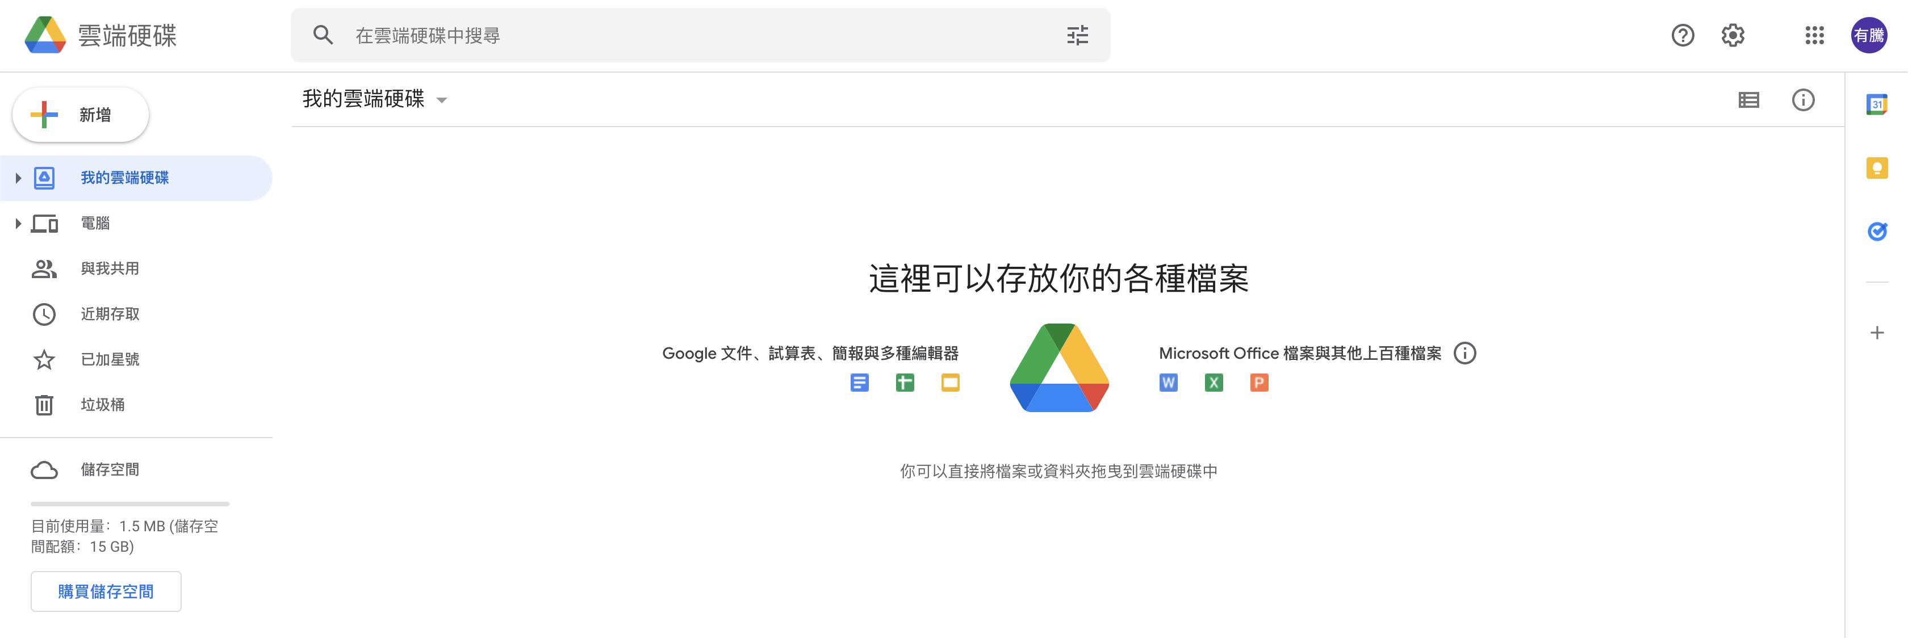
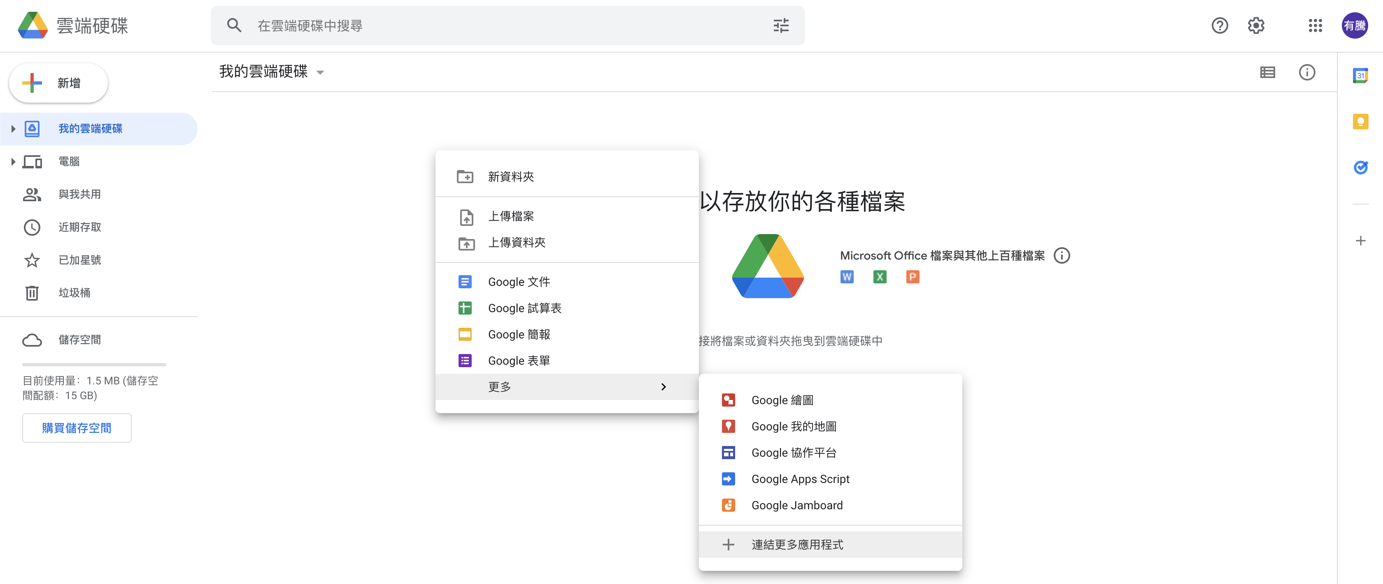
Connect Colab into Google Drive
We should connect Colab into google drive before we use it.
Right Click

Slide 6
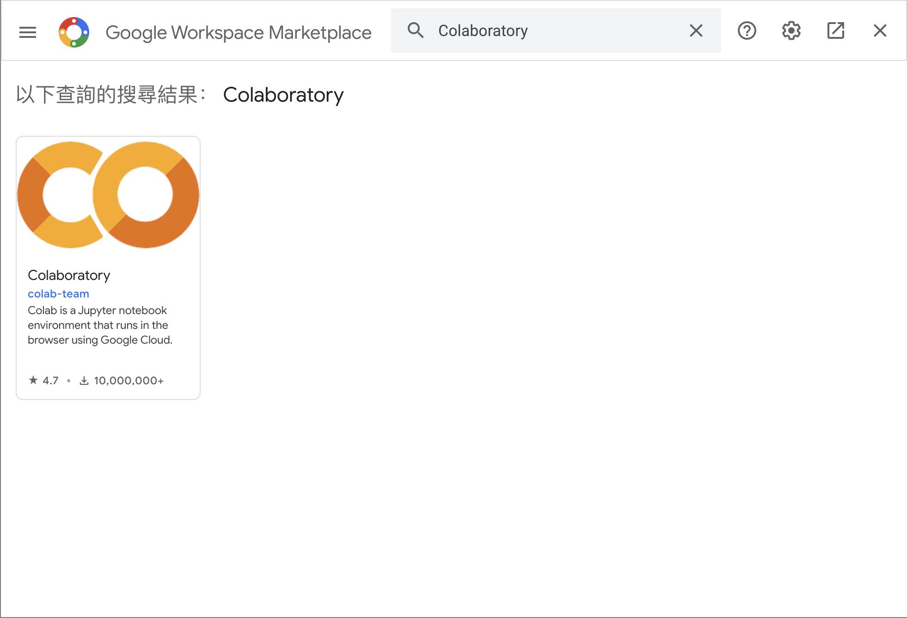

Connect Colab into Google Drive (Cont’d )
Search Colab and install it.

Slide 7
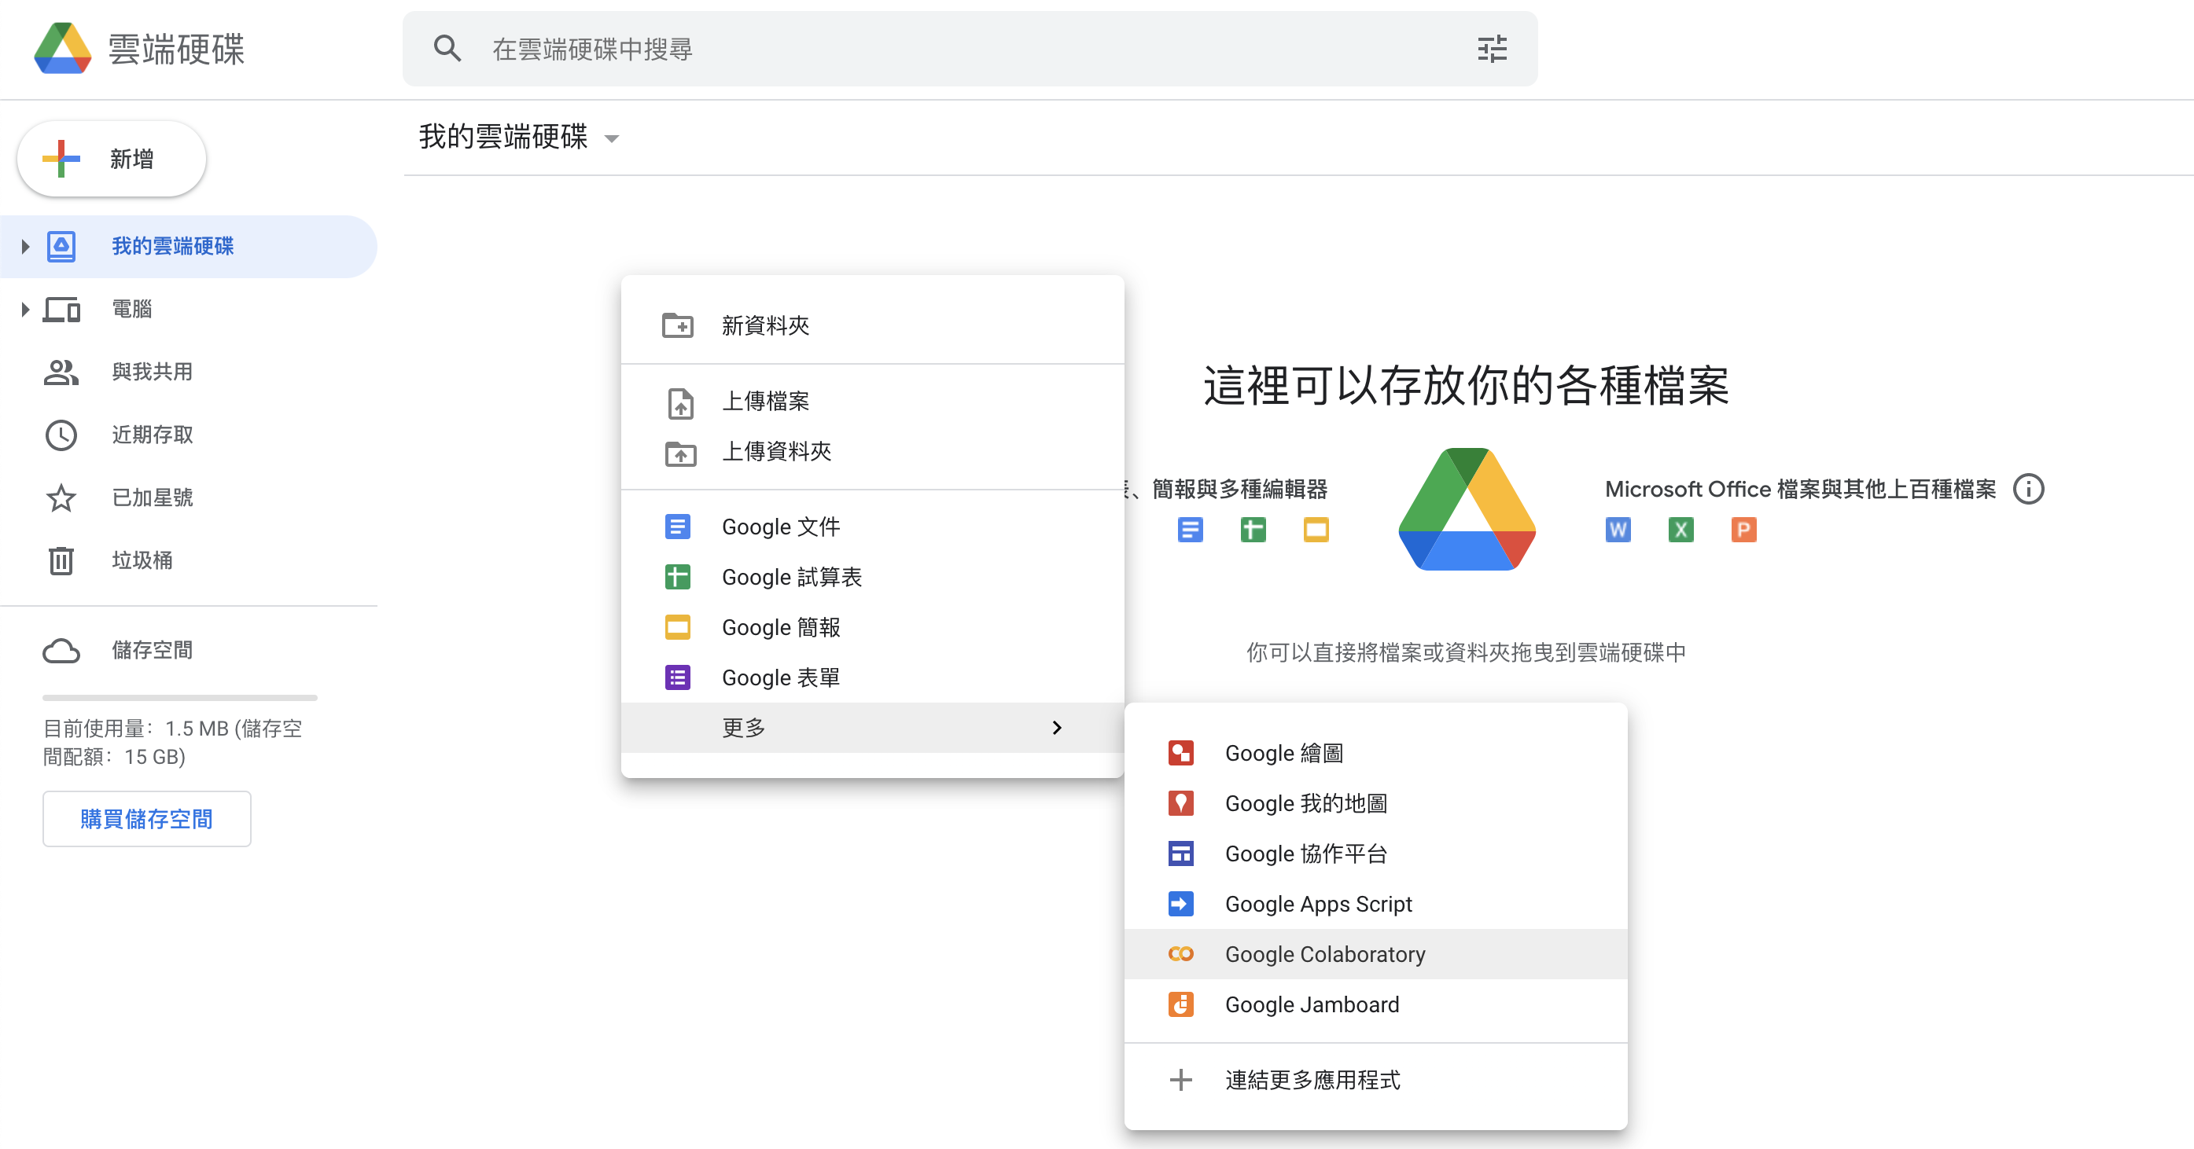
Connect Colab into Google Drive (Cont’d )
After installation, you can create a new Colab notebook.

Slide 8
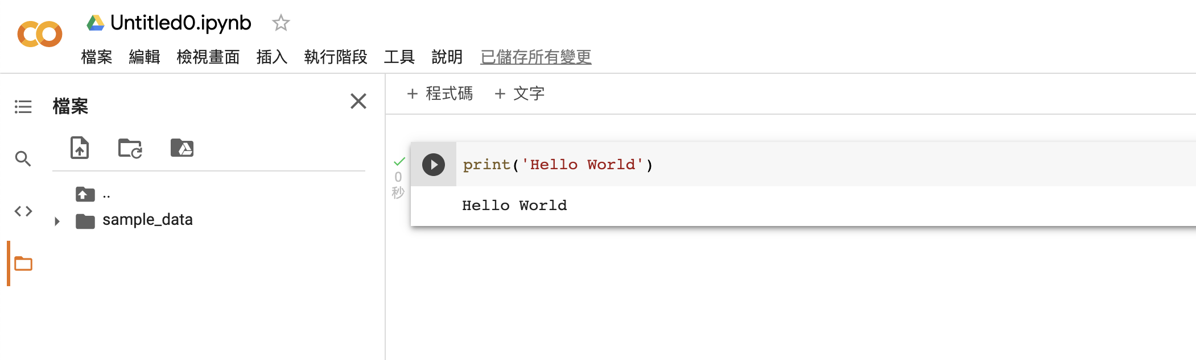
Colab User Interface (UI)
Notebook name
Python code
Code cell
Files
Output
Execute button

Slide 9
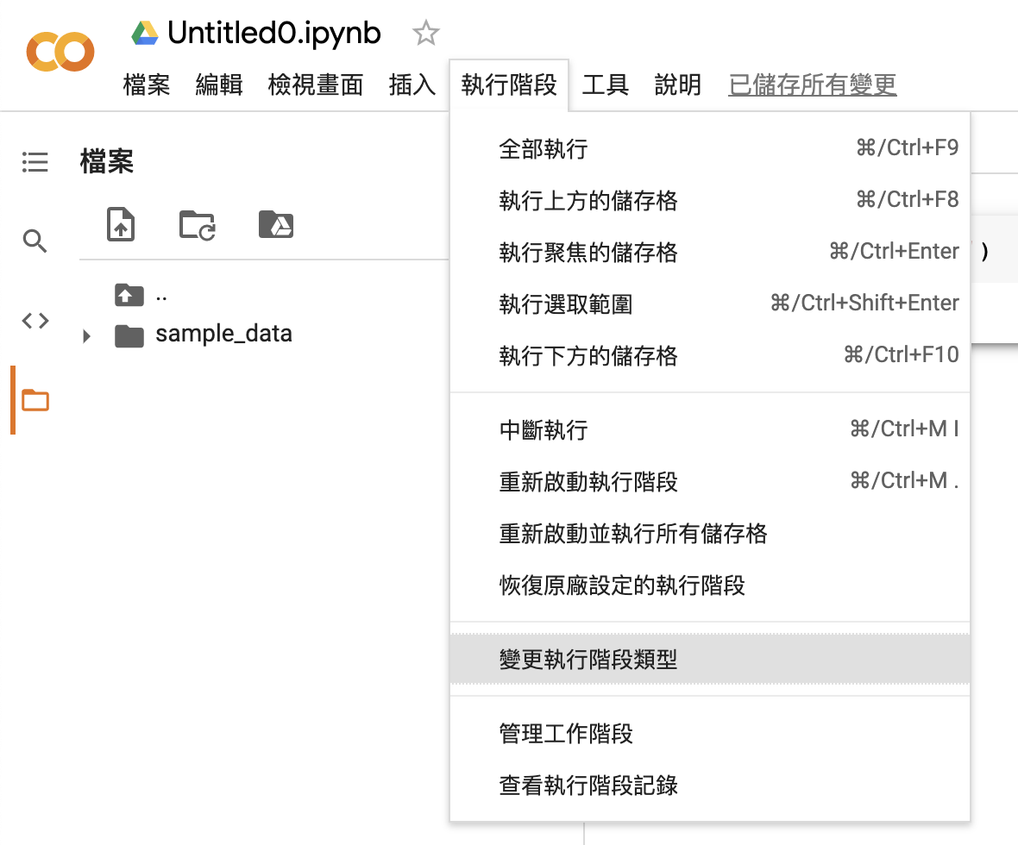
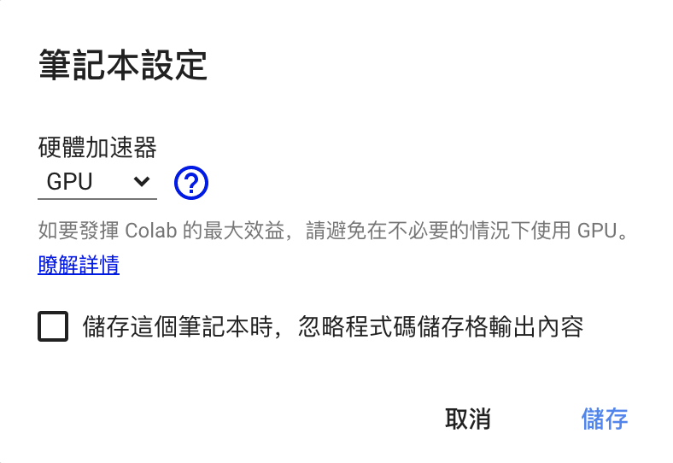
Change to Use GPU
We can change to GPU hardware accelerator.

Slide 10
Natural Language Processing in Spark
Use NLP to find the bullies lurking behind the Internet.

Slide 11
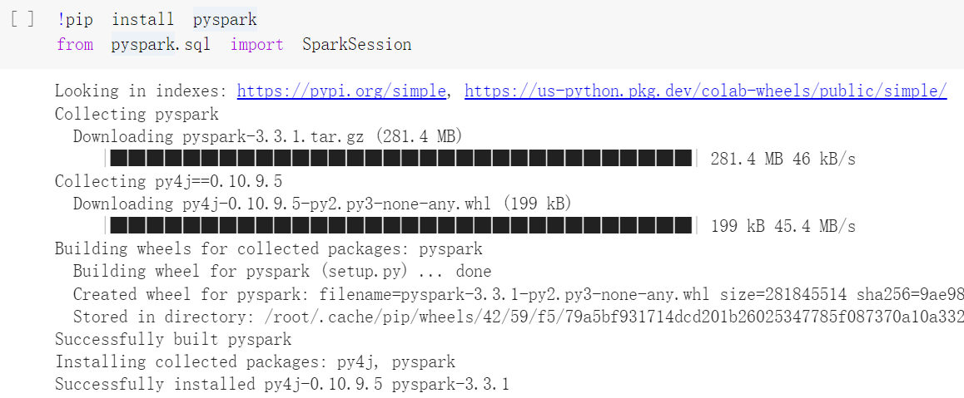
Install Pyspark on Colab
Install PySpark on Colab with !pip install pyspark.
Input from pyspark.sql import SparkSession to import and initialize SparkSession when executing Spark.

Slide 12
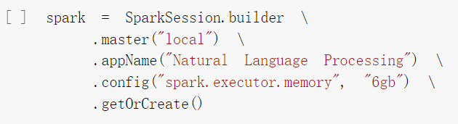
SparkSession
master(“local”): Set the Spark master URL to connect to, and “local” means to run locally.
appName(): Set a name for the application.
Config(): Configure 6 GB of space for spark.executor.memory.
getOrCreate(): Get an existing SparkSession or creates a new one based on the options set in the builder.

Slide 13
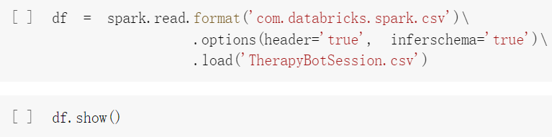
Create the Dataframe
Dataframe (df) is created by reading the CSV file (TherapyBotSession).
option(header=‘true’): Treat the first line of the CSV file as field names.
option(inferschema=‘true’): Spark will automatically go through the CSV file and infer the schema of each column.

Slide 14
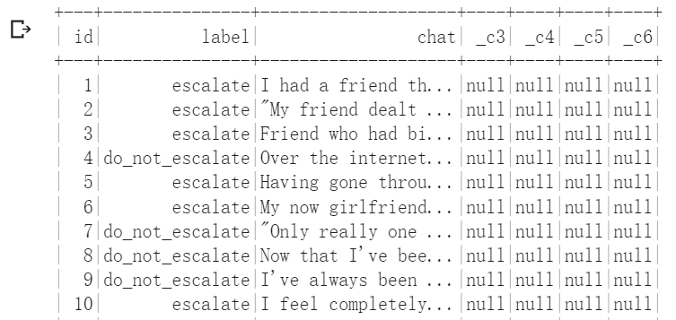
Create the Dataframe (Cont’d)
A part of dataframe is shown below.

Slide 15
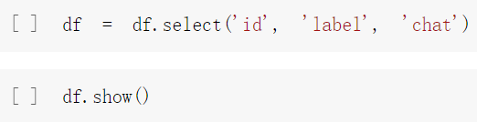
Remove Redundant Data
The dataframe, _c3, _c4, _c5, and _c6 that can be excluded from the dataset using the following script.
Use select() to choose the subset of a dataframe.

Slide 16
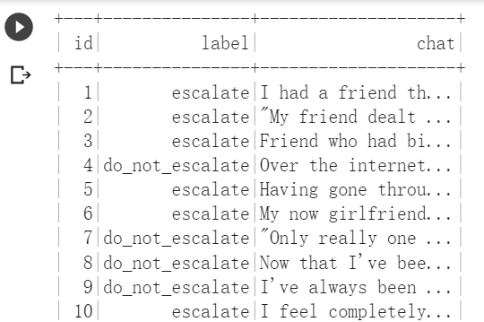
Remove Redundant Data (Cont’d)
A part of dataframe is shown below.

Slide 17
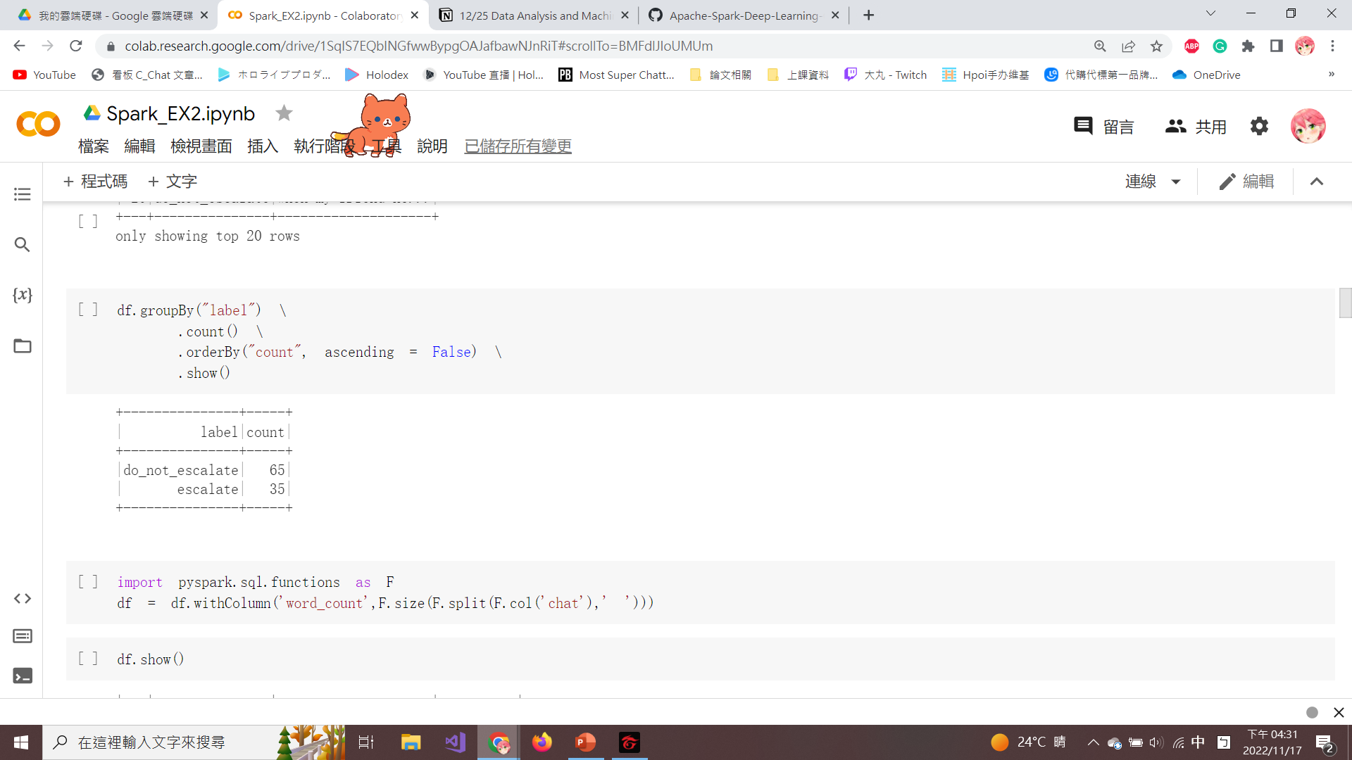
Ordering of Dataframe
groupby(): Group the label column and generate a count distribution.
orderby(“count”): Sort the dataframe by column counts.
“ascending=False”: The column is sorted in descending order.

Slide 18
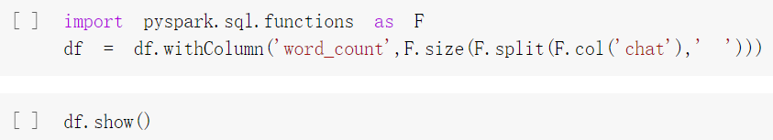
Create word_count Column
A new column (word_count) is created to calculate how many words are used in each of the 100 transactions.
withColumn(): Add a new column to dataframe.
size(): Calculate how many words are in each ‘chat’ column.

Slide 19
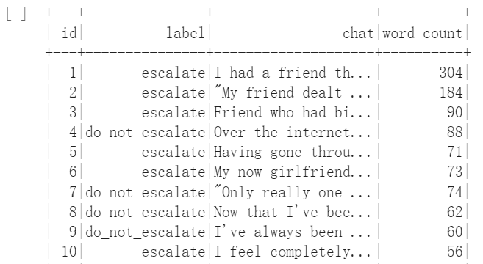
Create word_count Column (Cont’d)
The newly created column (word_count) is shown below.

Slide 20
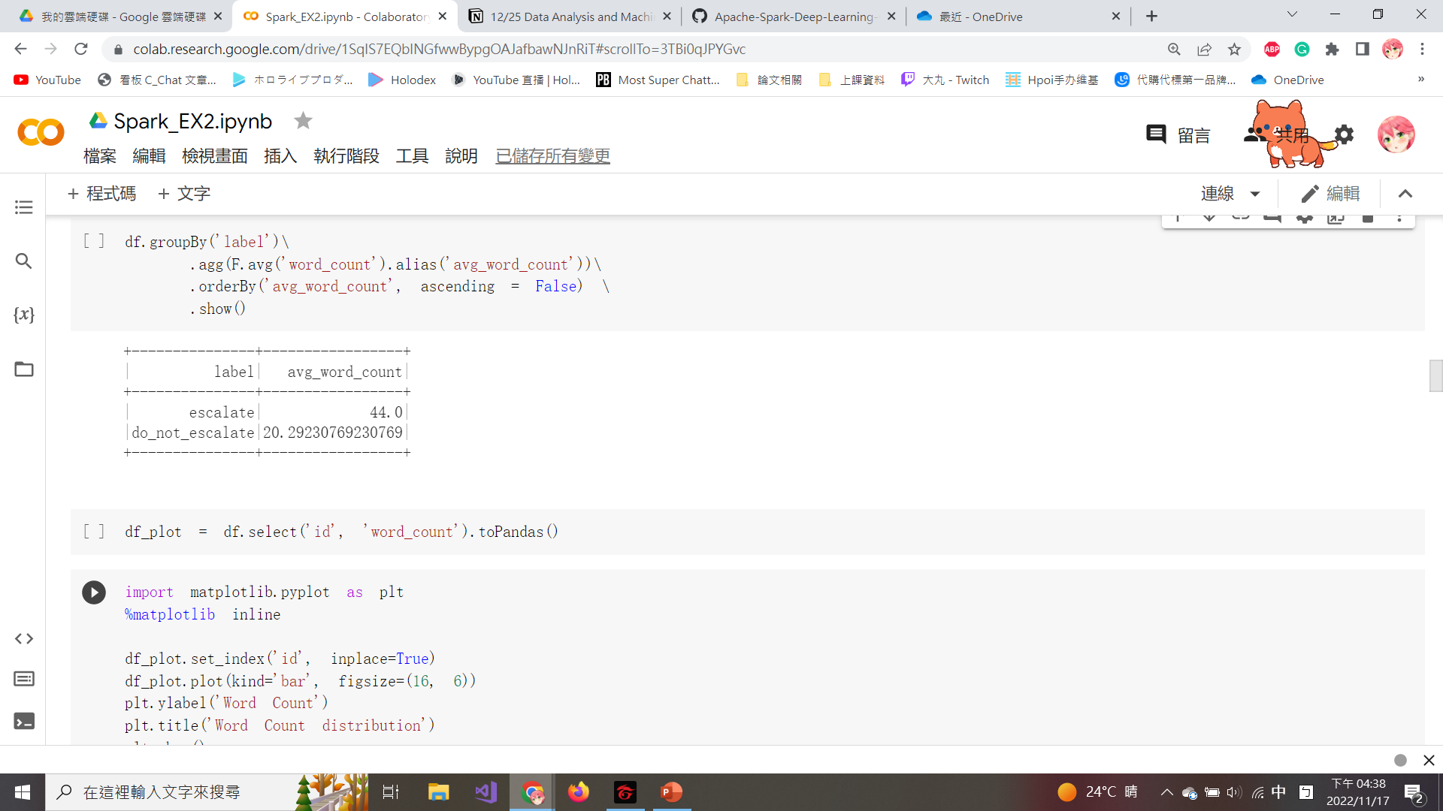
Calculate the Average Word Count
Dataframe can be aggregated by agg() to calculate the average word count by label column.
alias(): Give the second name to a piece of data.

Slide 21
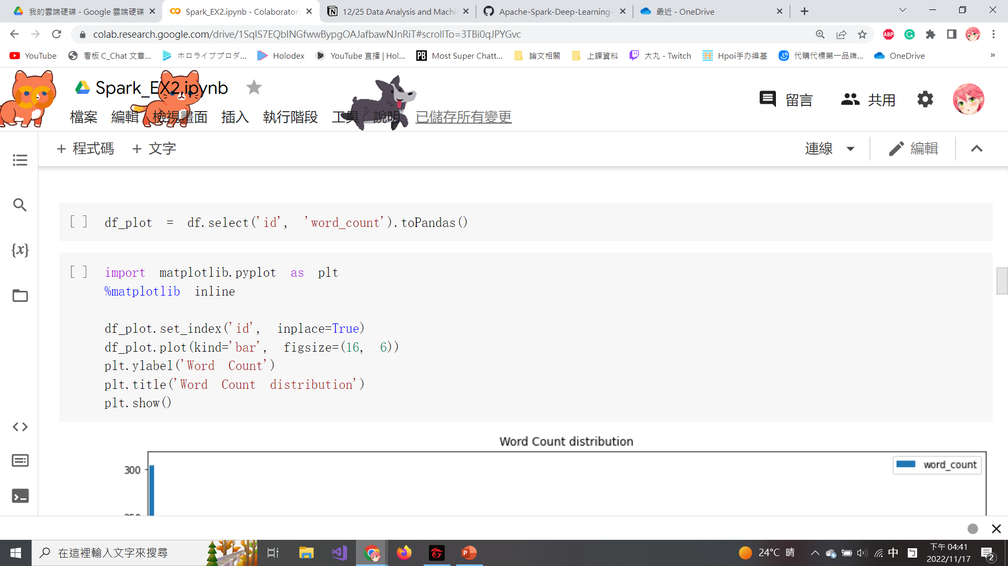
Import matplotlib
Convert Spark dataframe into a pandas dataframe by using toPandas().
Importing matplotlib for plotting.

Slide 22
Draw the Bar Chart
set_index(): Set the dataframe index to ‘id’ and when the set ‘inplace = True’, the reset_index method will directly modify and overwrite the original dataframe.
plot(): Assign the figure to bar chart and set the figure size.
title(): Set the title of the figure.
Set the y-values to be word_count by ylabel().

Slide 23
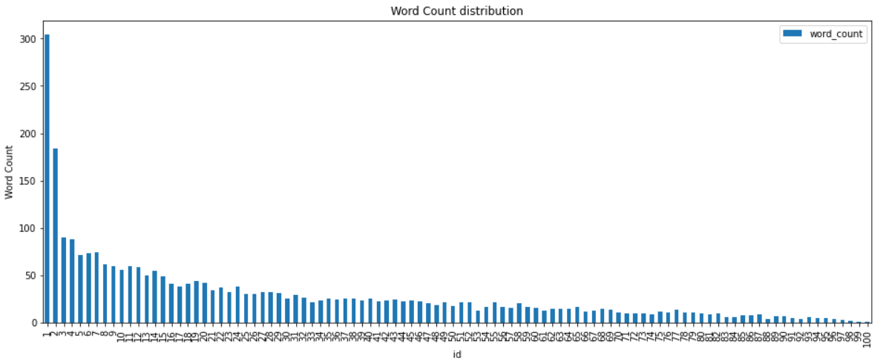
Draw the Bar Chart (Cont’d)
The bar chat is shown below.

Slide 24
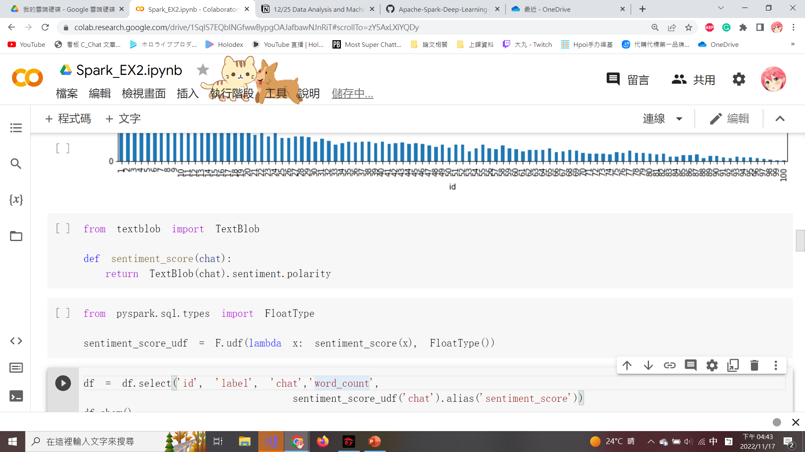
Import Textblob
Textblob is a sentiment analysis library in Python that can calculate the sentiment score.
sentiment.polarity: Calculate scores from -1 (very negative) to +1 (very positive), and 0 means neutral.
sentiment_score() is defined to generate the sentiment polarity of each conversation in a new column.

Slide 25
User-defined Function
Create a user-defined function (udf) in PySpark SQL.
Create a lambda function, called sentiment_score_udf that maps sentiment_score into a udf() to each transaction and specifies the output type to FloatType.

Slide 26
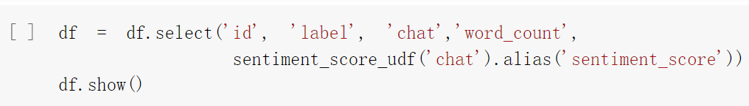
Calculate the sentiment_score
Apply the sentiment_score_udf() to each ‘chat’ column in the dataframe to calculate sentiment_score.
The updated dataframe with the newly created field (sentiment_score) can be seen by executing df.show().

Slide 27
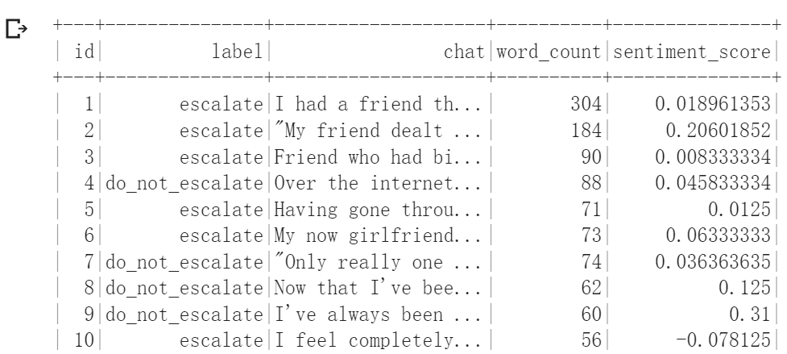
Calculate the sentiment_score (Cont’d)
The updated dataframe with sentiment_score is shown below.

Slide 28
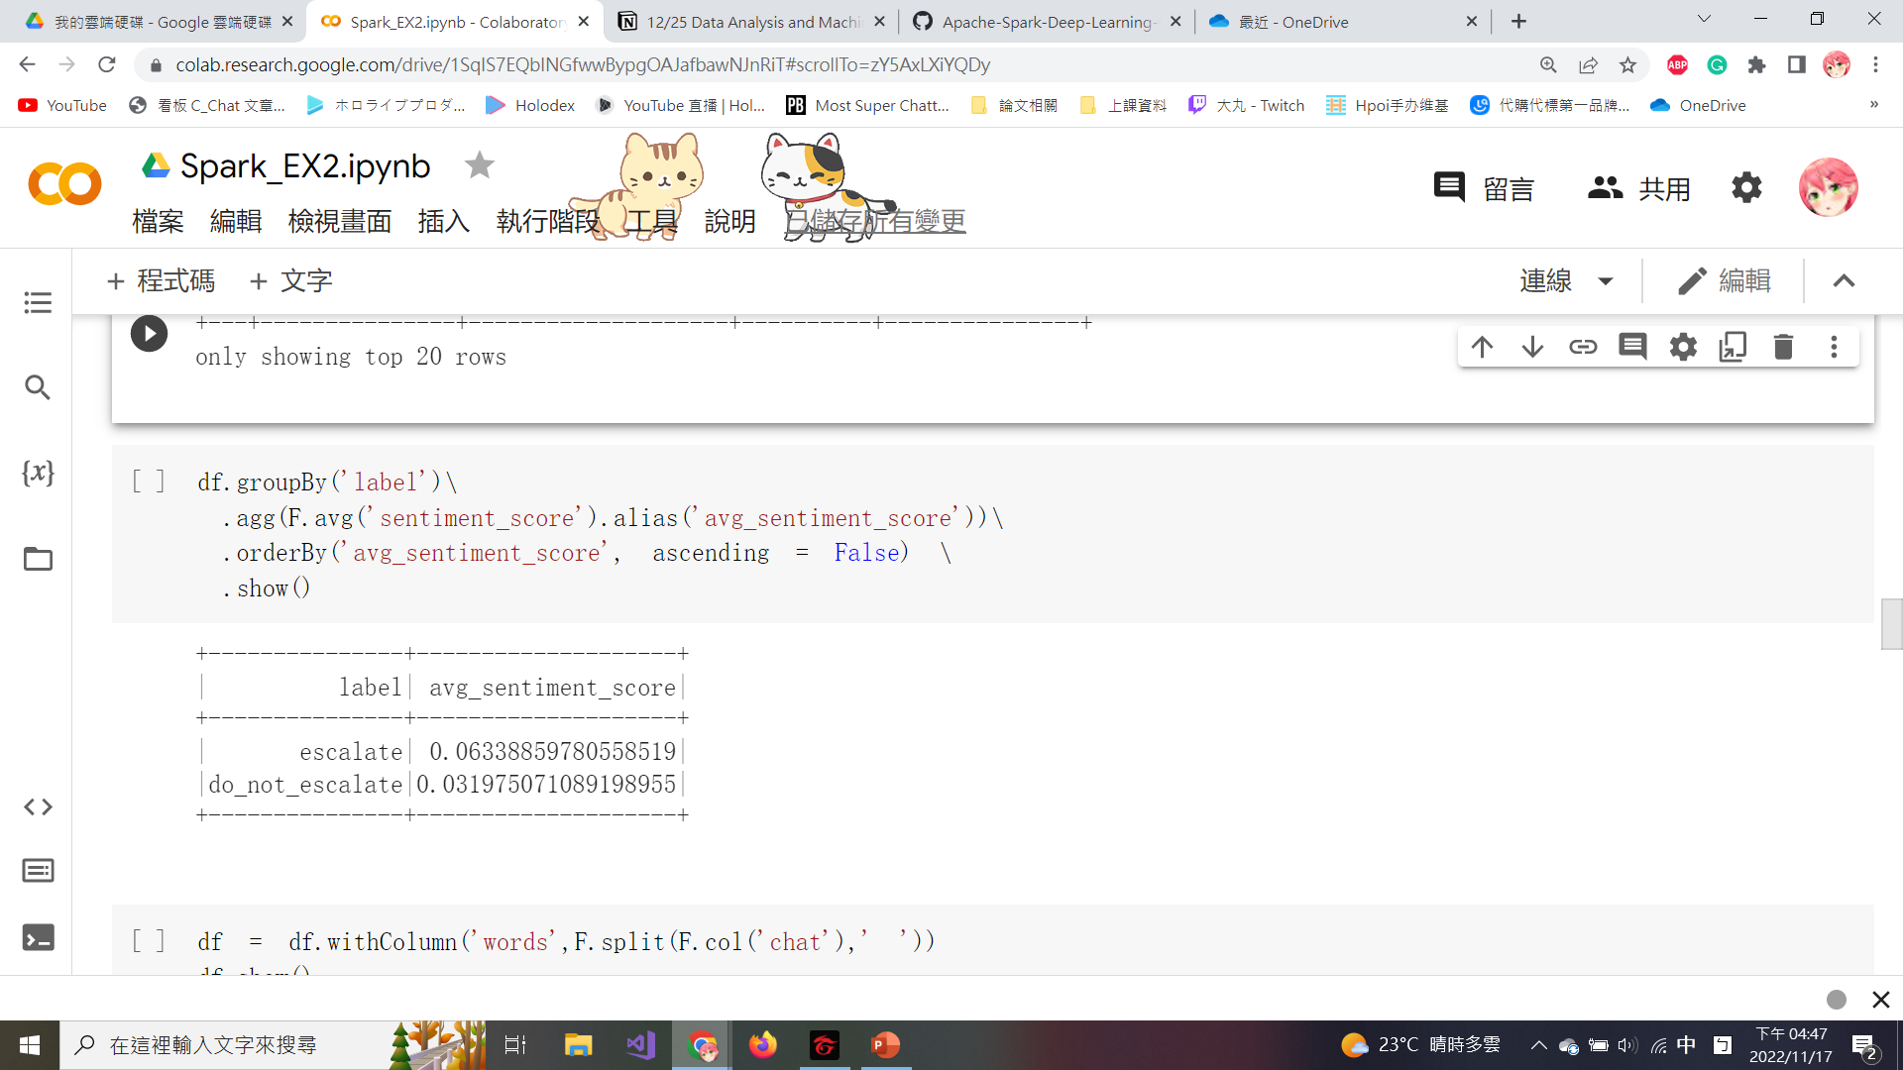
Calculate the Average Sentiment Score
Compare whether escalate conversations in the label are more positive or negative by calculating an avg_sentiment_score.

Slide 29
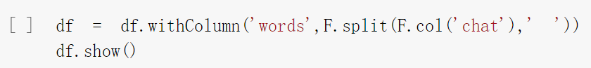
Convert each Word in ‘chat’ Column into a String
Execute the following script to convert each word in ‘chat’ column into a string within an array.

Slide 30
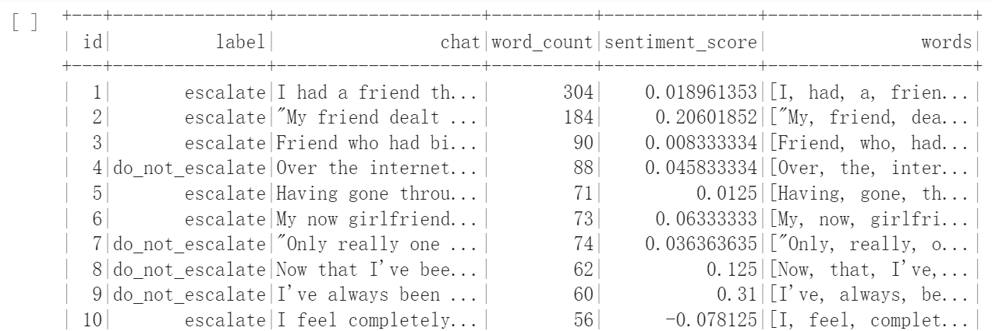
Convert each Word in ‘chat’ Column into a String (Cont’d)
The newly created column (words) is shown below.

Slide 31
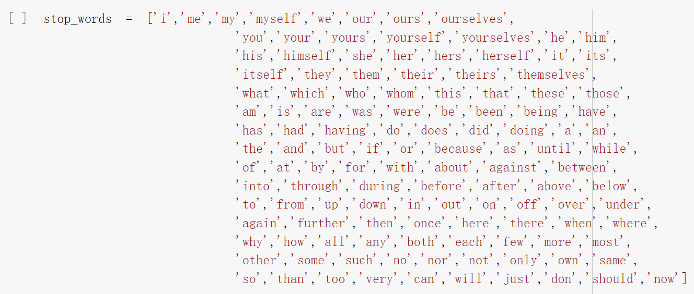
Stop Word in NLP
A stop word is a very common word used in the English and is often removed from common NLP techniques.
You can copy stop_word from the memo on this page.

Slide 32
Copy the Stop Word
stop_words = ['i','me','my','myself','we','our','ours','ourselves',
'you','your','yours','yourself','yourselves','he','him',
'his','himself','she','her','hers','herself','it','its',
'itself','they','them','their','theirs','themselves',
'what','which','who','whom','this','that','these','those',
'am','is','are','was','were','be','been','being','have',
'has','had','having','do','does','did','doing','a','an',
'the','and','but','if','or','because','as','until','while',
'of','at','by','for','with','about','against','between',
'into','through','during','before','after','above','below',
'to','from','up','down','in','out','on','off','over','under',
'again','further','then','once','here','there','when','where',
'why','how','all','any','both','each','few','more','most',
'other','some','such','no','nor','not','only','own','same',
'so','than','too','very','can','will','just','don','should','now']

Slide 33
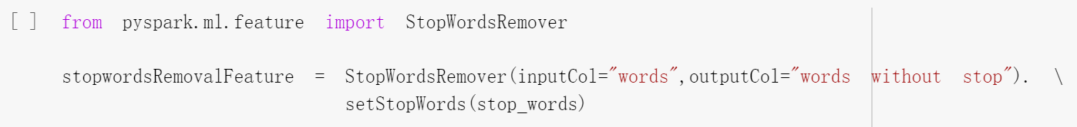
Remove the Stop Words
Import the StopWordsRemover function from PySpark to filter out columns by setting the inputCols parameter.
The newly created column is specified outputCol="words without stop“.
setStopWords(): Set the value of stop words.

Slide 34
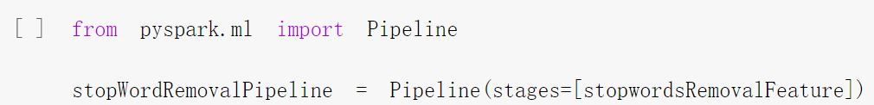
Remove the Stop Words (Cont’d)
Import Pipeline and define the stages as stopwordRemovalFeature to transform the dataframe.
MLlib consists of a sequence of Pipeline stages (estimator and transformer) to be run in a specific order.

Slide 35
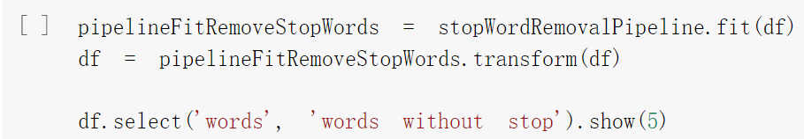
Remove the Stop Words (Cont’d)
Estimator stage: The fit() is called to produce a transformer.
Transformer stage: The transform() is called on the dataframe for stop word removal transformation.

Slide 36
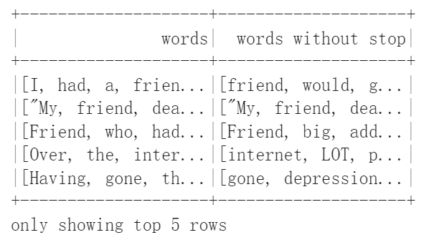
Remove the Stop Words (Cont’d)
The dataframe with a new column called words without stop is shown below.

Slide 37
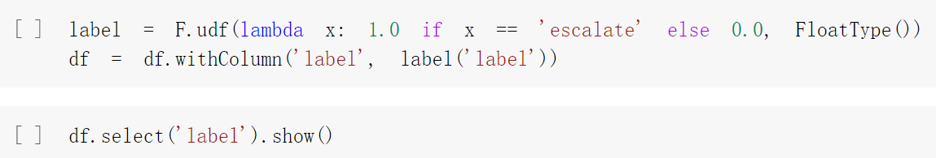
Classify the Label and Assign Values
If the data in the label column is ‘escalate’ the numerical values will assign to 1, otherwise assign to 0.
All labels under the label column are converted to a numerical label of 0.0 or 1.0 with FloatType().

Slide 38
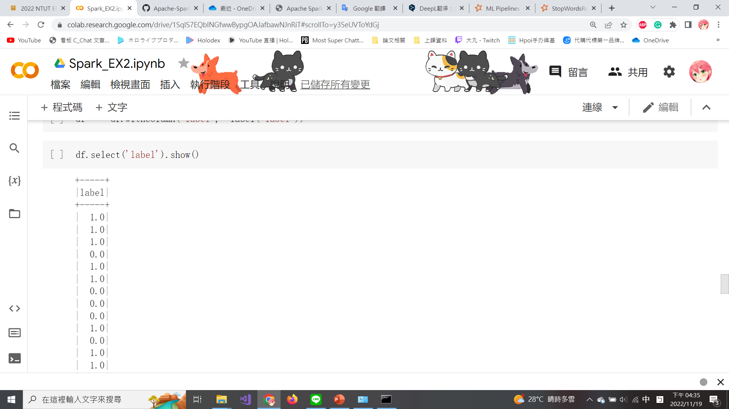
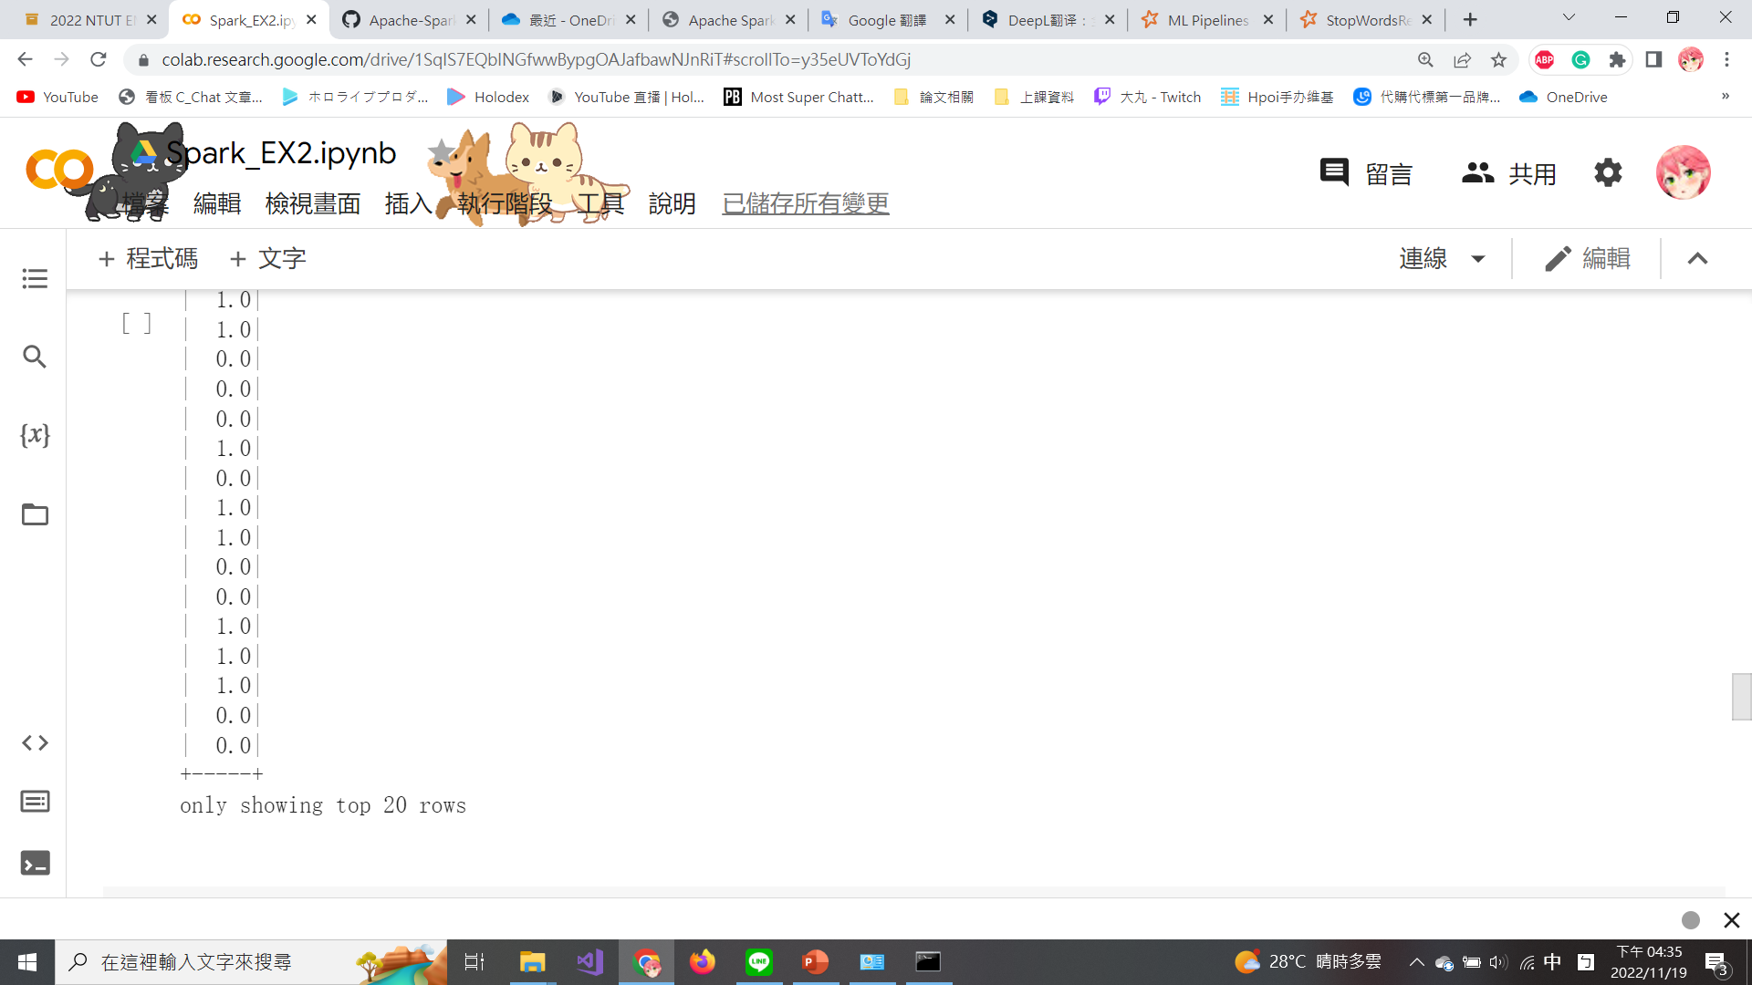
Classify the Label and Assign Values (Cont’d)
The label column is converted to a numerical label of 0.0 or 1.0 as shown in the figure.

Slide 39
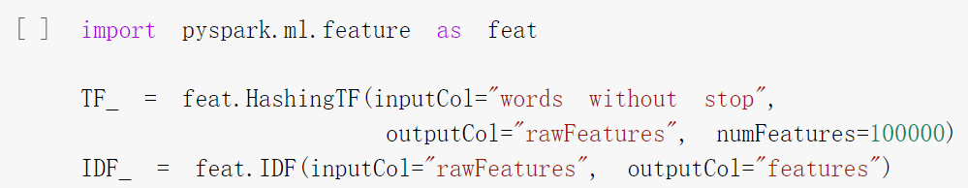
TF-IDF
Term frequency-inverse document frequency (TF-IDF) is a feature vectorization method widely used in text mining to reflect the importance of a term to a document in the corpus.
TF-IDF models require a two-step approach by importing both HashingTF() and IDF() from pyspark.ml.feature.
The numFeatures parameter is set to 100,000 to ensure that it is larger than the distinct number of words in the dataframe.

Slide 40
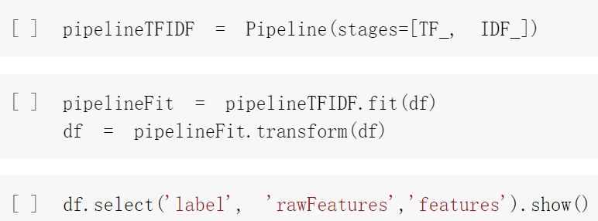
TF-IDF (Cont’d)
Define the stages as [TF_, IDF_] to order the sequence of steps where IDF will follow HashingTF.
The HashingTF class can count the number of times each word appears in a document and save it as a vector.
The more a word appears in certain documents, the larger the IDF is, and the more important it is to the entire corpus. vice versa.

Slide 41
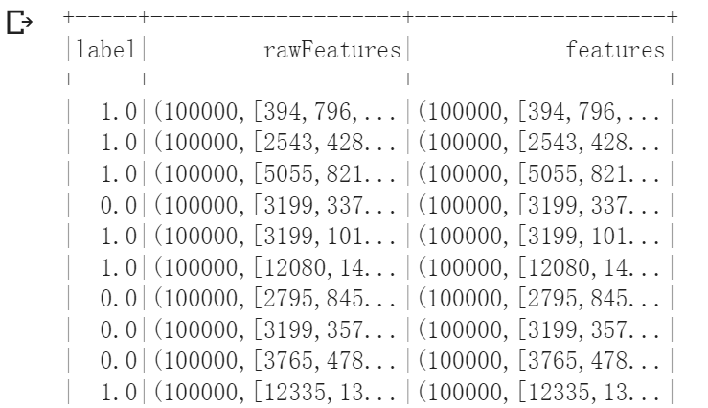
TF-IDF (Cont’d)
The 2 new columns are shown below.

Slide 42
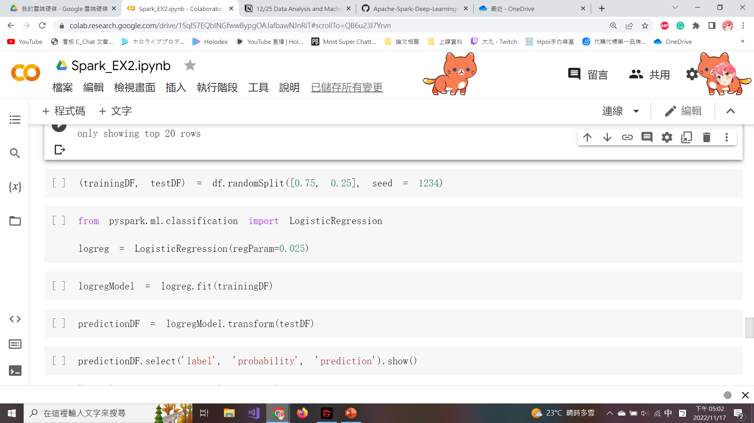
Logistic Regression Model
For training purposes, the dataframe will be split as 75:25 with a random seed set at 1234.
Use a traditional classification algorithm such as a logistic regression model from PySpark.
The logistic regression model is configured with a regularization parameter, regParam as 0.025.

Slide 43
Logistic Regression Model (Cont’d)
The logistic regression model (logregModel) is trained and fitted on trainingDF.
predictionDF is created based on the transform() from the logistic regression model.

Slide 44
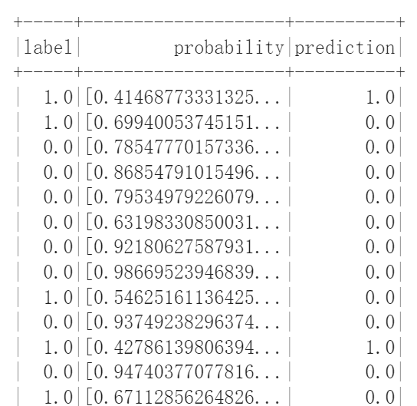
Logistic Regression Model (Cont’d)
The probability and prediction are shown in the figure.

Slide 45
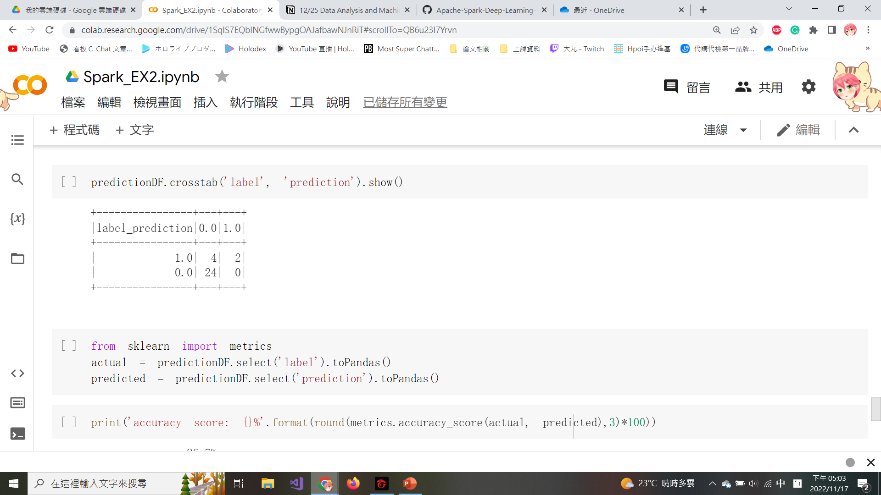
Create Confusion Matrix
crosstab(): Compute a simple cross-tabulation of 2 (or more) factors.
A confusion matrix is helpful to quickly summarize the accuracy numbers between actual results and predicted results.

Slide 46
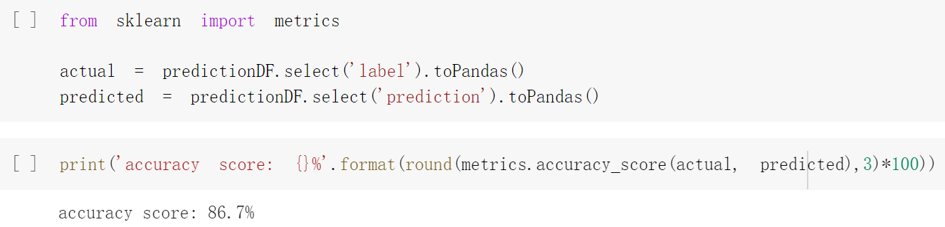
Compute the Prediction Accuracy
The sklearn.metrics module implements several loss, score, and utility functions to measure probability estimates of the positive class.
The “actual” values are tied to the label column.
The “predicted” values are tied to the prediction column.
metrics.accuracy_score(): Compute subset accuracy.

Slide 47
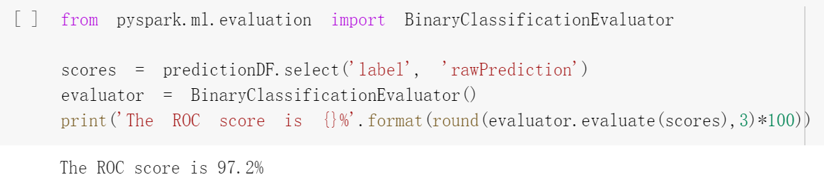
Compute ROC Score
The ROC (Receiver Operating Characteristic) is often associated with measuring the performance of the model.
Import the BinaryClassificationEvaluator function to calculate the ROC.
evaluate(): Evaluate the output with optional parameters.

Slide 48
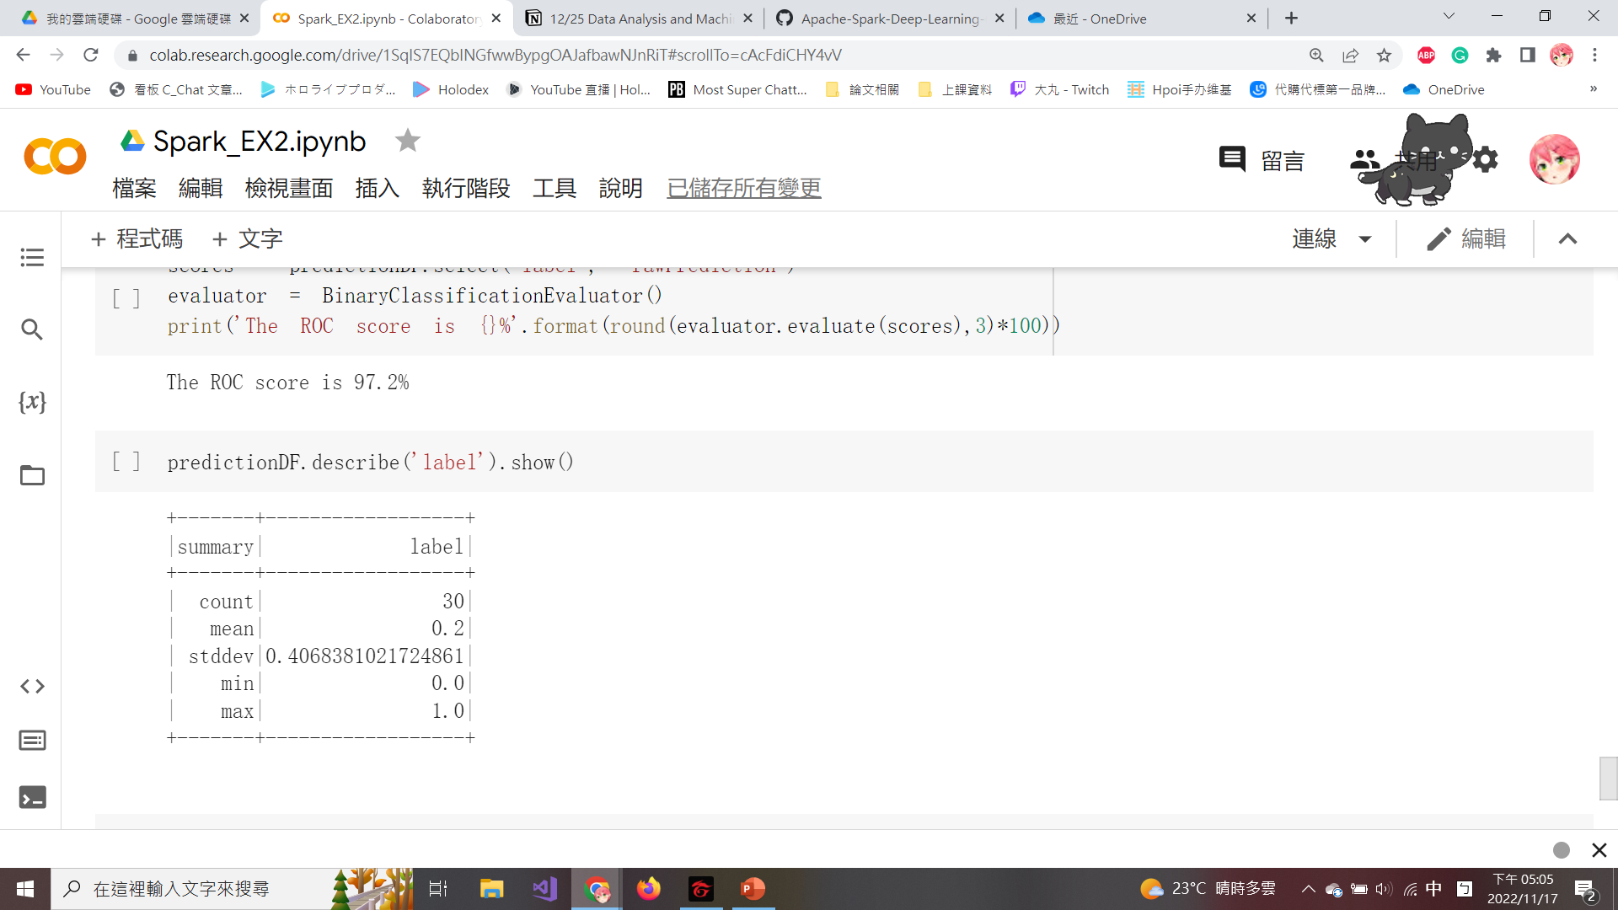
Evaluation Results and Conclusions
describe(): View some basic statistical details such as percentiles, mean, standard deviation, etc.
If we labeled each conversation as do_not_escalate, we would be correct ~80% of the time, which is less than our model accuracy of 86.7%.
Our model performs better than a blind baseline performance model.

Slide 49
Predicting Apple’s Stock Price by Using Keras

Slide 50
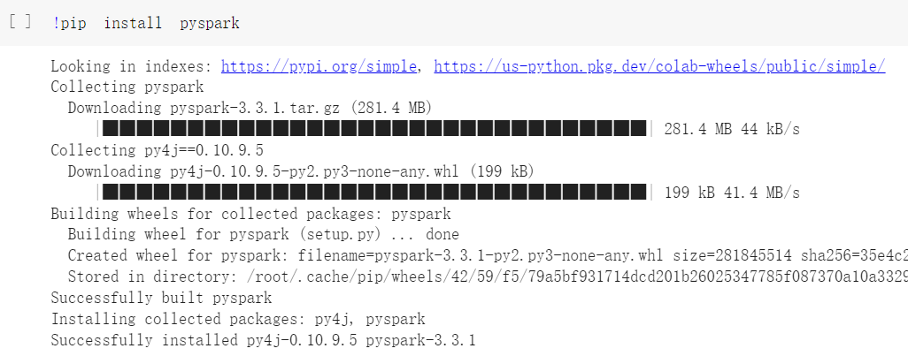
Install Pyspark
Create a new file in Google Colab and install pyspark with !pip install pyspark.

Slide 51
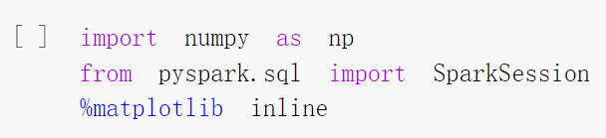
Import the Libraries
Numpy is a basic function library required for scientific operations using Python, including array operations.
You can invoke the Numpy functions with np.
Load Numpy with import numpy as np.

Slide 52
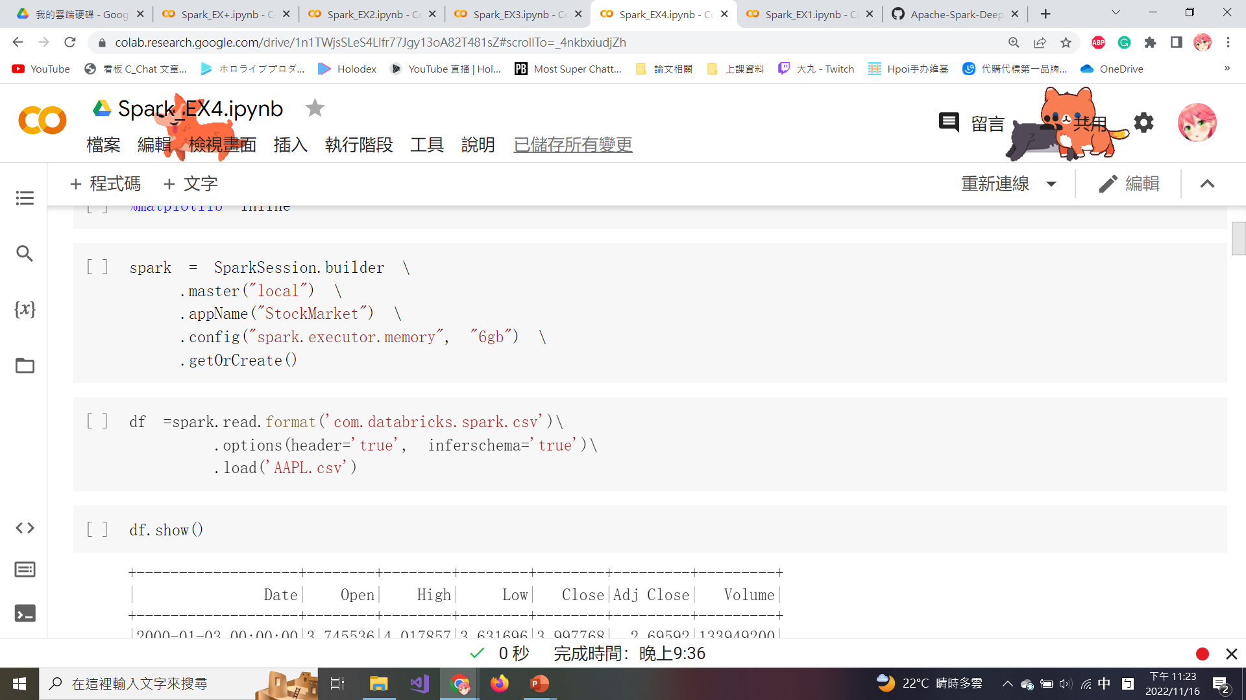
SparkSession
master(“local”): Set the Spark master URL to connect to, and “local” means to run locally.
appName(): Set the app name to “StockMarket”.
Config(): Configure 6 GB of space for spark.executor.memory.
getOrCreate(): Get an existing SparkSession or creates a new one based on the options set in the builder.

Slide 53
Create the Dataframe
Dataframe is created by reading the file “AAPL.csv”.
option(header=‘true’): Treat the first line of the CSV file as field names.
option(inferschema=‘true’): Spark will automatically go through the CSV file and infer the schema of each column.

Slide 54
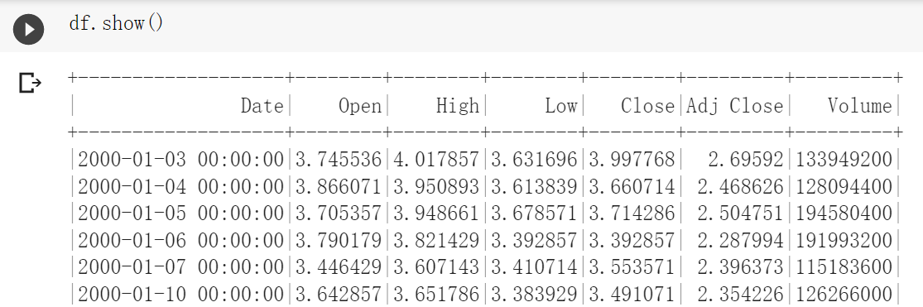
Create the Dataframe (Cont’d)
A part of dataframe is shown below.

Slide 55
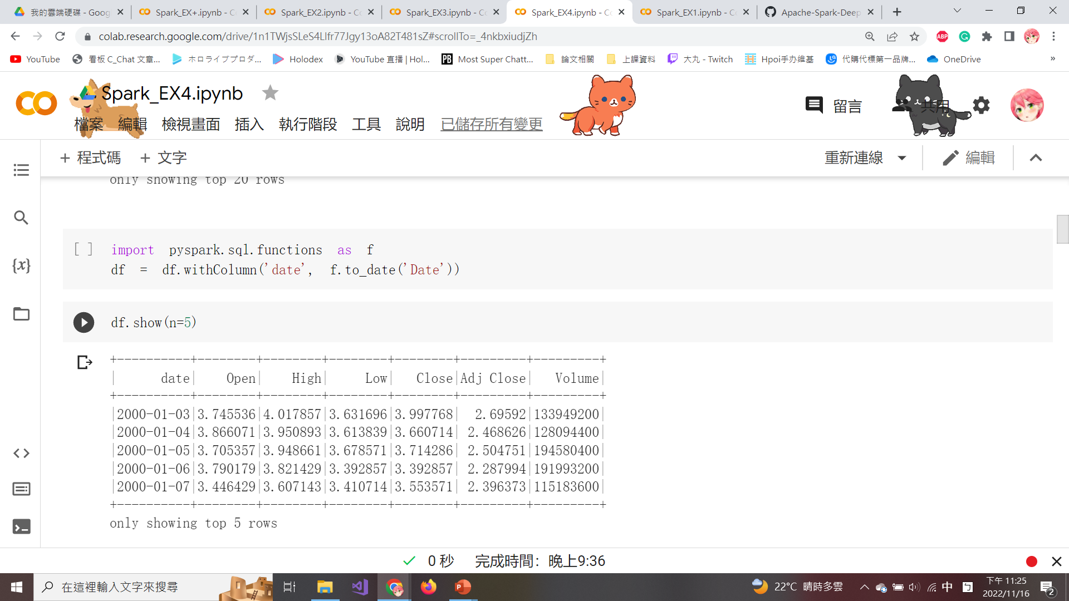
Transform the Format to Date
The ‘Date’ column a date-time format with the time values all ending in 00:00:00.
Use to_date() to transform the ‘Date’ column to date format and use the withColumn() to transform the dataframe.

Slide 56
Transform the Format to Date (Cont’d)
The new ‘Date’ column without the timestamp is shown below.

Slide 57
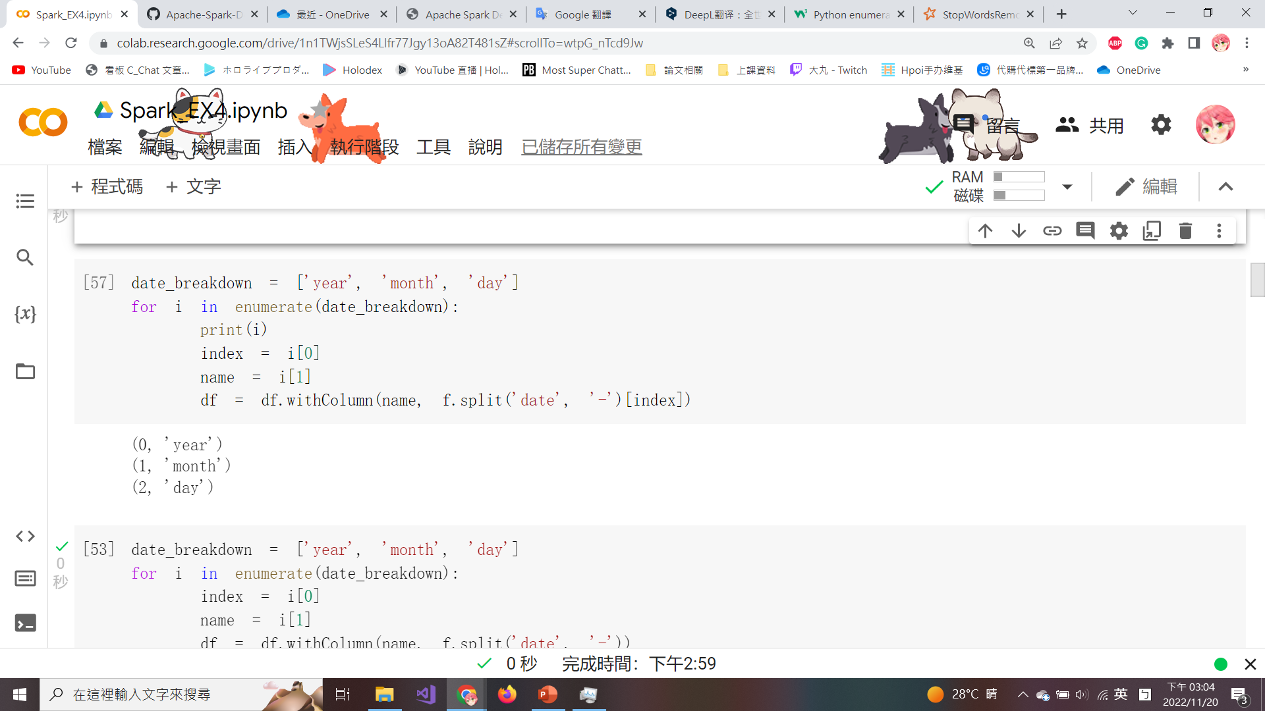
Enumerate and Add the New Column
The enumerate() is used to combine a traversable data object (such as a list) into an index sequence and list the data and its subscripts at the same time, which is generally used in the for loop.
spit() is used to split the date column by a ‘-’ and then use withColumn() to add a new column for the year, month, and day.

Slide 58
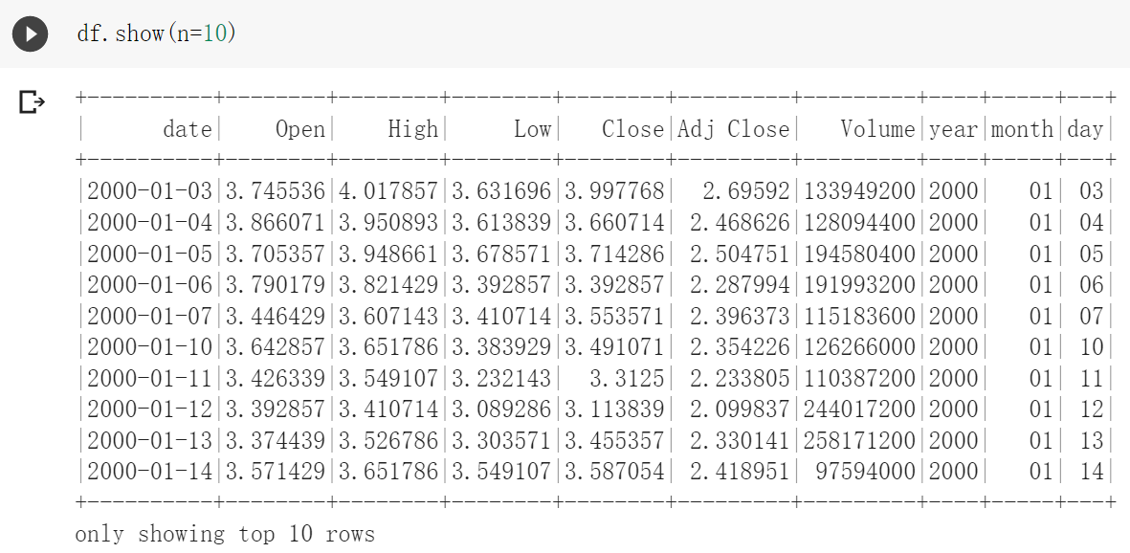
Enumerate and Add the New Column (Cont’d)
The updated dataframe with the newly added columns is shown below.

Slide 59
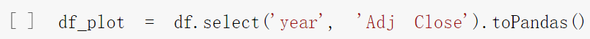
Convert Spark Dataframe to Pandas
Spark dataframes are more limited in visualization features than pandas dataframes.
Convert subset 2 columns ‘year’ and ‘Adj Close’ from Spark dataframe to a pandas dataframe by using toPandas() for plotting a line chart.

Slide 60

Import matplotlib
matplotlib is a classic library for visualizing data with Python, available for Python development environments such as Google Colab.
set_index(): Set the dataframe index to ‘year’.
plot() which “grid=True” is used to display the grid in the figure.

Slide 61

Time-series vs. Stock Quote
The final time-series vs. stock quote plot is shown below.

Slide 62

Remove Null Values
shape function is used to get the count of the (rows, columns).
dropna(): Find the null value of the dataframe, delete the row or column where the null value is located, and return the new dataframe.

Slide 63

Apple Stock Stats
The row count, mean, standard deviation, minimum, and maximum values of the statistics for Open, High, Low, Close, and Adj Close can be seen in the following screenshot.

Slide 64

Get the Number of Trading Days
Use the groupBy() to group the ‘year’ column by the ‘Adj Close’ count to get the total number of stock trading days for each year.
withColumnRenamed() is used to rename the column from ‘count (Adj Close)’ to ‘Row Count’.

Slide 65

Get the Number of Trading Days (Cont’d)
The dataframe to get a total count of stock trading days per year is shown in the figure.

Slide 66

Training Data & Testing Data
The data between 2017 and 2018 represents approximately 7% of the total data and is used to be testing data.
The remaining 93% of the dataset will be used for training purposes (training data) between 2000 and 2016.

Slide 67
Training Data & Testing Data (Cont’d)
The training dataset (trainDF) contains 4,277 rows.
The testing dataset (testDF) contains 333 rows.

Slide 68

Apple’s Stock Price
Use toPandas() to convert the trainDF.
Leverage the built-in graphing capabilities in matplotlib to visualize the data.
Show Apple's stock price from 2000 to 2016.

Slide 69

Apple’s Stock Price (Cont’d)
A line chart showing Apple's stock price from 2000 to 2016.

Slide 70

Apple’s Stock Price (Cont’d)
Use toPandas() to convert the testDF.
Leverage matplotlib to visualize the data.
Show Apple's stock price from 2017 to 2018.

Slide 71

Apple’s Stock Price (Cont’d)
A line chart showing Apple's stock price from 2017 to 2018.

Slide 72

Convert Dataframe to Numpy Array
When working with neural networks, it is best to keep the values between 0 and 1 to match outcomes found in sigmoid or step functions.
We must first convert our pyspark dataframes (trainDF and testDF) into NumPy arrays: trainArray and testArray.

Slide 73

Convert Dataframe to Numpy Array (Cont’d)
The first values in ‘trainArray’ and ‘testArray’ are shown below.

Slide 74


Scale Array Values
Scale array values to a range between 0 and 1 which involves using the following formula:
scaled array value = $(array value − min⁡array value) / (max⁡array value − min⁡array value)$.
We can use the MinMaxScaler() from sklearn library to scale both array values in simple.

Slide 75

Scale Array Values (Cont’d)
MinMaxScaler() is fit on the training array and is applied to create 2 brand new arrays, ‘trainingArray’ and ‘testingArray’, that are scaled to values between 0 and 1.

Slide 76
Scale Array Values (Cont’d)
The first scaled values in ‘trainingArray’ and ‘testingArray’ are shown below.

Slide 77

Values to Train & Test
The first 5 elements in the array are the features as the x-values and the last element is the label as the y-value.
The features are composed of the values from Open, High, Low, Close, and Volume. The label is composed of Adj Close.
xtrain
ytrain

Slide 78


Values to Train & Test (Cont’d)
The first row of xtrain, ytrain, xtest & ytest are shown in the figure.

Slide 79

Validate the Correctness of Shape
Check the shape of the 4 arrays that will be used in the model to confirm that 5 elements for features (x-values), and one element for the label (y-values), as can be seen in the following figure.

Slide 80

Quotes of xtrain
The values for the training array (xtrain), for open, low, high, and close can be plotted using the newly adjusted scales between 0 and 1.

Slide 81

Quotes of xtrain (Cont’d)
The adjusted scales between 0 and 1 for open, low, high, and close, as shown in the figure.

Slide 82

Volume of xtrain
The volume can also be plotted with the scaled volume scores between 0 and 1.

Slide 83

Volume of xtrain (Cont’d)
The adjusted scales between 0 and 1 for volume, as shown in the following figure.

Slide 84

Build the Model
Import keras in pyspark to build the LSTM model with models and layers libraries.
The LSTM model will be defined using a Sequential() that works with time series that are sequence-dependent.

Slide 85
Build the Model (Cont’d)
input_shape = (1,5): One dependent variable and 5 independent variables in the training dataset.
Only one Dense layer will be used to define the neural network.
mean_squared_error calculation is best to determine how close the predicted value is to the actual value.
Optimizer is defined as ‘adam’ which gives good results when being used with recurrent neural networks.

Slide 86

Build the Model (Cont’d)
xtrain and xtest are currently two-dimensional arrays, to incorporate them into the LSTM model, they will need to be converted to three-dimensional arrays by using reshape().

Slide 87

Train the Model
The model is fit with xtrain and ytrain which batch_size is set to ten with hundred epochs.

Slide 88

Show the Model
The mean squared error loss in each epoch is visualized.
After the fifth or sixth epoch, we can see that the loss gradually flattens out, as shown in the screenshot on the right-hand side.

Slide 89

Model Predict
predict() is used in batch processing of large numbers of inputs and generates output predictions for the input samples.
concatenate(): Combine 2 NumPy arrays column-wise by specifying axis=1.

Slide 90

Model Predict (Cont’d)
Execute the following code to plot the actual vs. predicted stock prices.

Slide 91

Model Predict (Cont’d)
The predictions are close to the actual stock quotes from 2017-2018, as shown in the following figure.

Slide 92

Model Predict (Cont’d)
Mean_squared_error is calculated to understand how much deviation is between the predicted and actual stock prices.
As shown in the following figure, we have a mean squared error of 0.0222 or approximately 2.2%.

Slide 93

Extra Bonus
Download the current Apple stock price from the following website:
https://finance.yahoo.com/quote/AAPL/history

Slide 94
Extra Bonus (Cont’d)
Use a line chart to draw the actual stock price in 2022 against your predicted stock price, such as the following picture.

Slide 95
Real Estate Value Visualization and Predict with XGBoost

Slide 96

Import Needed Library
seaborn is a visualization library required for analysis and plots.
mpt_toolkits contains functions required by Matplotlib.
sklearn is the primary scientific and statistical library required in this section.

Slide 97

Read the Data from CSV File
The data is read into a Pandas dataframe using the read_csv().
The headers are listed using the list(dataframe) command, as shown below.

Slide 98

Print the Dataframe
The head of the dataframe can be printed by using the dataframe.head() as shown below.

Slide 99

Print the Dataframe (Cont’d)
The tail of the dataframe can be printed by using the dataframe.tail() as shown below.

Slide 100

Print the Dataframe (Cont’d)
describe() is used to obtain basic statistics such as the maximum, minimum, and mean values under each column.

Slide 101

Number of bedrooms
Plot the count of bedrooms with a bar chart.
value_counts(): Return an object containing counts of values.

Slide 102

Number of bedrooms (Cont’d)
The bar chart of bedroom counts are shown below.

Slide 103


Number of bedrooms (Cont’d)
Plot a pie chart of the dataframe by assigning kind='pie'.

Slide 104


Number of Floors
Let’s plot the number of floors in houses that are sold most frequently.
The bar chart is categorized by the number of floors as shown in the figure.

Slide 105

Locations of House Sold
We need to know what locations have the highest number of houses sold.
jointplot(): Draw a plot of 2 variables by using the latitude and longitude variables from the dataset with bivariate and univariate graphs.

Slide 106

Locations of House Sold (Cont’d)
The density of houses sold at different locations, as shown in the figure.
It is clear that some locations see a higher density of house sales compared to others.

Slide 107


Price vs. Bedroom Numbers
Draw a plot of the price versus the number of bedrooms the house obtained.
We realize that the trends regarding the number of bedrooms in a house are directly proportional to the price of up to 6 bedrooms, and then it becomes inversely proportional.

Slide 108

Price vs. Living Area
We observe how the price compares to the living area of all the houses sold.
scatter(): Draw a scatter plot that uses dots to represent values for 2 different numeric variables.

Slide 109

Price vs. Living Area (Cont’d)
The price gives us an expected trend of increasing prices with the increasing size of the house.

Slide 110


House Conditions vs. Price
On plotting the figure house conditions vs. price, we notice an expected trend of increasing prices with higher house ratings, as shown in the figure.

Slide 111

Zip Code vs. Price
Using the following commands, we can learn which zip codes have the most house sales in the dataframe.

Slide 112

Zip Code vs. Price (Cont’d)
We noticed that certain zip codes have a higher density of houses sold compared to other areas.
Compare the house price with zip codes to understand which areas are wealthier neighborhoods.

Slide 113

Model Prediction
Since we have 21 columns, it becomes difficult to build models by incorporating all variables in one single model.
Dropping the id and date features from the dataset because they are unnecessary in our predicted model.

Slide 114

Model Prediction (Cont’d)
After dropping the id and date columns, the new dataframe contains 19 variables, as shown below.

Slide 115

Model Prediction (Cont’d)
We want to observe the correlation between price and other variables.
copy(): Copy the variable of house prices into a new dataframe.

Slide 116

Model Prediction (Cont’d)
The correlation between price and every other variable can be manually found by using corr().

Slide 117
Model Prediction (Cont’d)
Pearson's correlation coefficient is the most commonly used coefficient. The correlation coefficient usually takes on a value between -1 and +1.
A correlation coefficient of +1 means that for every positive increase in one variable, there is a positive increase of a fixed proportion in the other.
A correlation coefficient of -1 means that for every positive increase in one variable, there is a negative decrease of a fixed proportion in the other.
Zero means that for every increase, there isn't a positive or negative increase. The two variables just aren't related.

Slide 118

Model Prediction (Cont’d)
The correlation between price and other variables are shown in the following figure.

Slide 119

Model Prediction (Cont’d)
The correlation coefficients can be found by using the simplified code that gives the same values.
iloc[] can specify the variable position in a boolean array (from 0 to length-1 of the axis).

Slide 120

Model Prediction (Cont’d)
sns.pairplot() will create a grid of axes to plot multi figures that correspond to y-variables (e.g. bedroom and bathroom) and a single row of the x-variable (e.g. price).
Note that ‘price’ is on the x-axis for each plot.

Slide 121


Model Prediction (Cont’d)
bedrooms vs. price
bathrooms vs. price

Slide 122


Model Prediction (Cont’d)
floors vs. prices
sqft_living vs. prices

Slide 123

Model Prediction (Cont’d)
Drop the ‘price’ column from the x_df dataframe and save it into a new dataframe named x_df2.
Use the LinearRegression() in the sklearn library to fit data to train and build regression models.

Slide 124
Model Prediction (Cont’d)
Split the dataset with the train_test_split() in sklearn.
train_test_split(): Split arrays or matrices into random train and test subsets.
Fit the model over the training data.

Slide 125

Model Prediction (Cont’d)
Print the coefficients applying linear regression to the training and testing dataset by using the reg.coef_ command.

Slide 126

Model Prediction (Cont’d)
View the result of each column prediction in the x_test dataset generated by the linear regression model.

Slide 127

Model Prediction (Cont’d)
Print the accuracy of the model by using reg.score().
The accuracy is 70.37%, which is not bad for a linear model as shown in the following screenshot.

Slide 128

Model Prediction (Cont’d)
If we want our model to be more accurate, we will have to use a more complex model.
XGBoost is the model we will use in this section to improve the accuracy obtained through linear regression.
Install and import the XGBoost library.

Slide 129

Model Prediction (Cont’d)
XGBRegressor(): Generate a Boosting model.
learning_rate: Boosting learning rate.
max_depth: Maximum tree depth for base learners.
Detailed parameter descriptions will be placed in the appendix.
Notes:
n_estimators: Number of gradient-boosted trees. Equivalent to a number of boosting rounds.
learning_rate: Boosting learning rate.
gamma: Minimum loss reduction required to make a further partition on a leaf node of the tree.
subsample: Subsample ratio of the training instance.
colsample_bytree: Subsample ratio of columns when constructing each tree.
max_depth: Maximum tree depth for base learners.
n_estimators：梯度提升樹的數量。 相當於若干個boosting輪次。
learning_rate：模型學習率，避免花費大量時間做收斂。
gamma：在樹的葉節點上進行進一步分區所需的最小損失減少。
subsample：訓練實例的子樣本比例。
colsample_bytree：構建每棵樹時列的子樣本比例。
max_depth：基礎學習者的最大樹深度。

Slide 130

Model Prediction (Cont’d)
Split the data into testing and training datasets and fit the new model.
The output is shown below.

Slide 131

Model Prediction (Cont’d)
Import explained_variance_score() to calculate the score of the regression model.
The newly fitted model to predict the house prices which accuracy is 87.34%. This is considered optimal.

Slide 132

Extra Bonus 2
According to the graph analysis on page 105, what other information can be observed from the graph besides house prices? And what other variables do you think are suitable for observation using this graph beside the latitude and longitude? Please plot your thought as the following figure and describe your thoughts in detail.
Please directly write your description in the cell in Colab with #.

Slide 133
Send Your Works
After finishing the extra bonus, please download the code as .ipynb file.
Send your exercise and bonus files to the mail: t110368019@ntut.org.tw
The title of the email should be in the following format: Student ID_Name_Bonus (ex: 109368091_詹景淳_Bonus).
The deadline for this exercise is 12/27/2022.

Slide 134
Thank you!

